Slide 1
natl_gaps_core_scenario
Pipeline: Natl Vessel Core Scenario
Vessel Pathway: Common
Port Pathway: Common

Slide 2
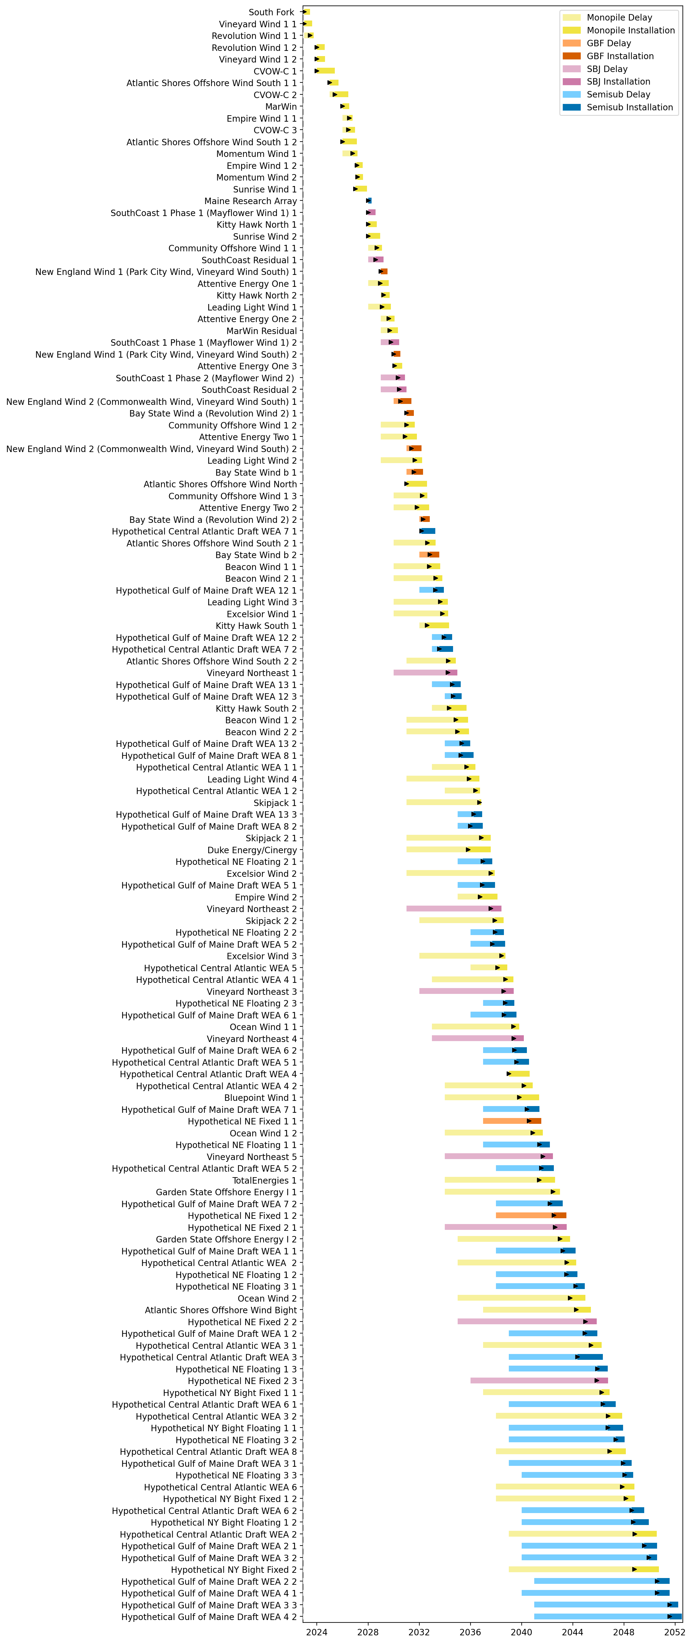
Full Gantt

Slide 3
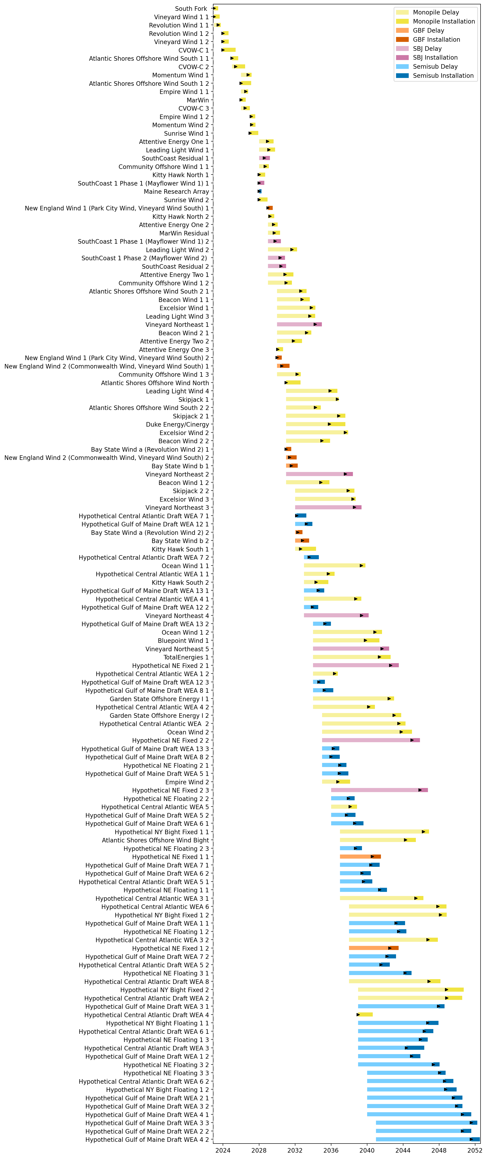
Sorted Full Gantt

Slide 4
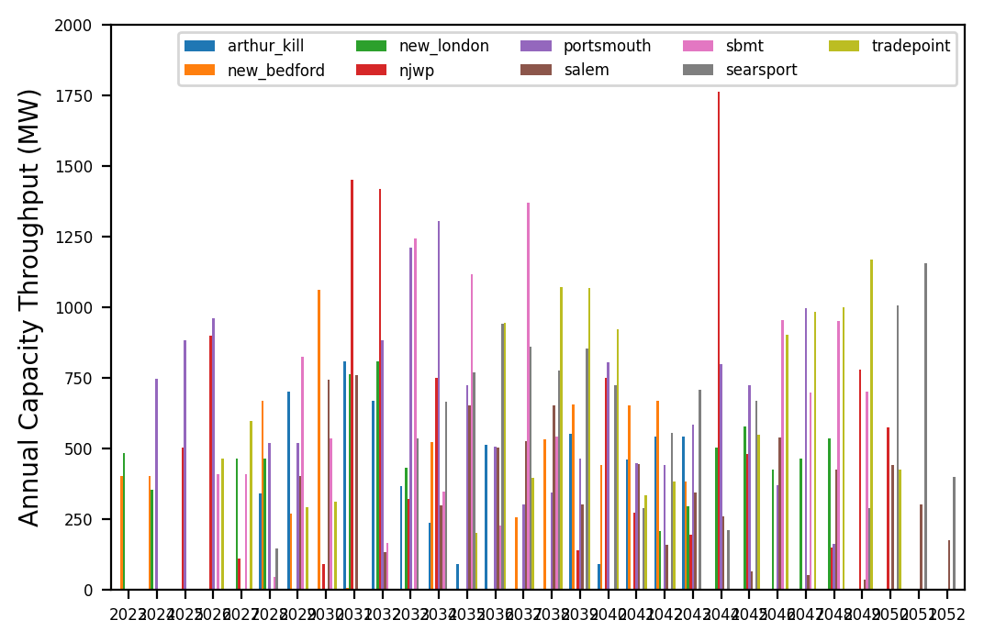
Port Throughput

Slide 5
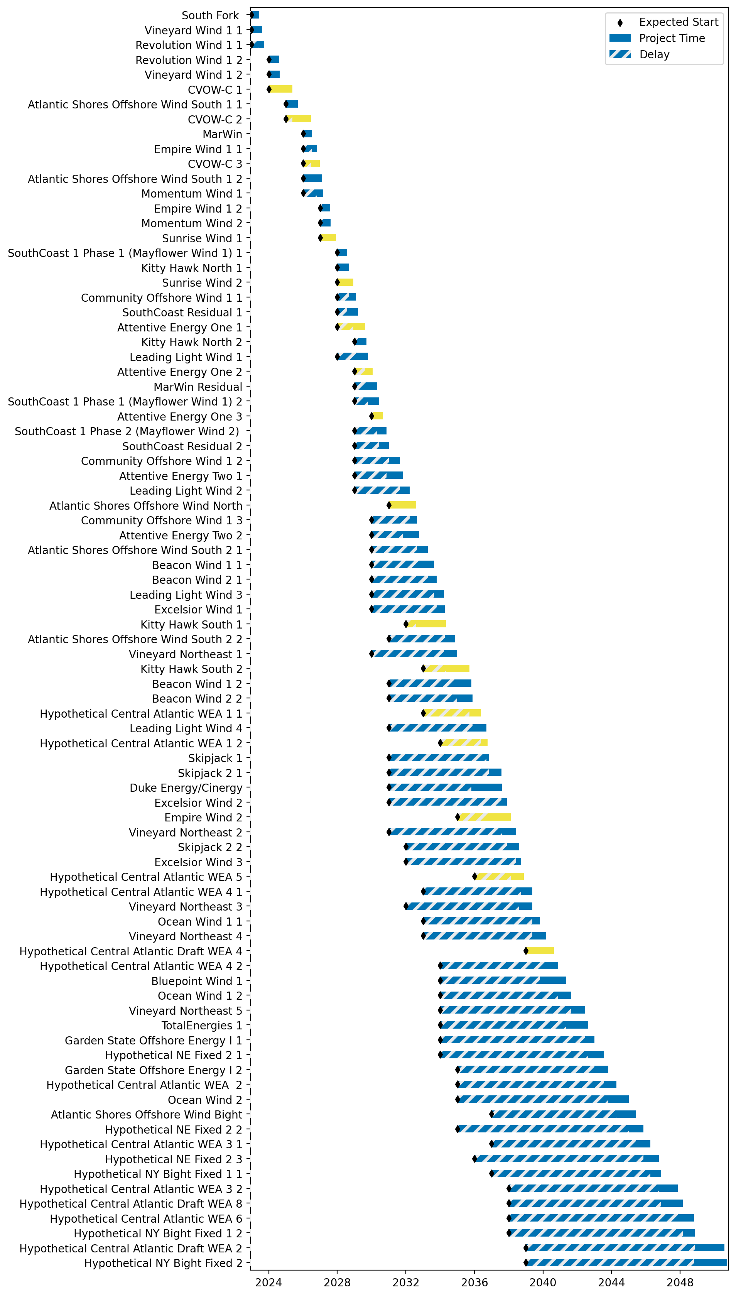
Fixed Gantt

Slide 6
natl_gaps_wtiv
Pipeline: Natl Vessel Core Scenario
Vessel Pathway: Common
Port Pathway: Common

Slide 7
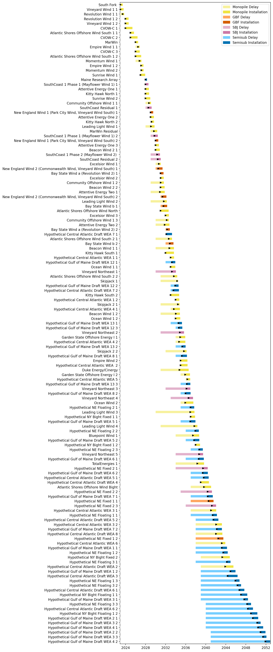
Full Gantt

Slide 8
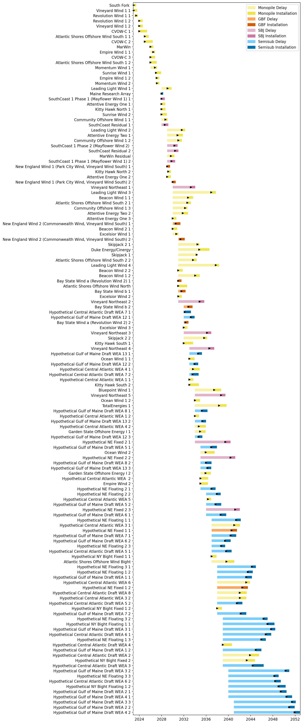
Sorted Full Gantt

Slide 9
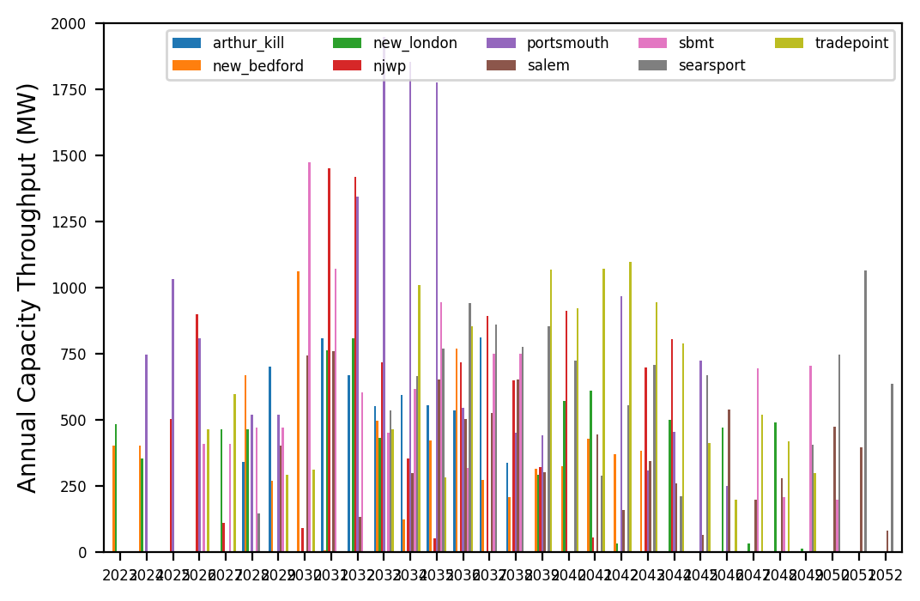
Port Throughput

Slide 10
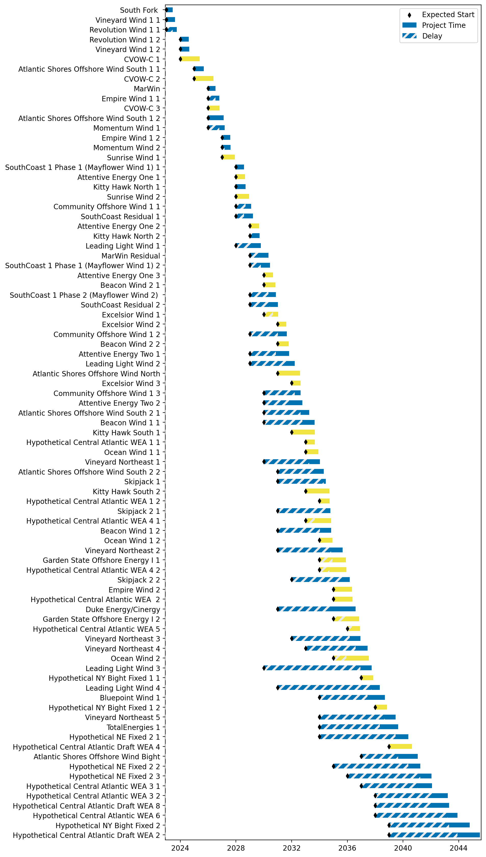
Fixed Gantt

Slide 11
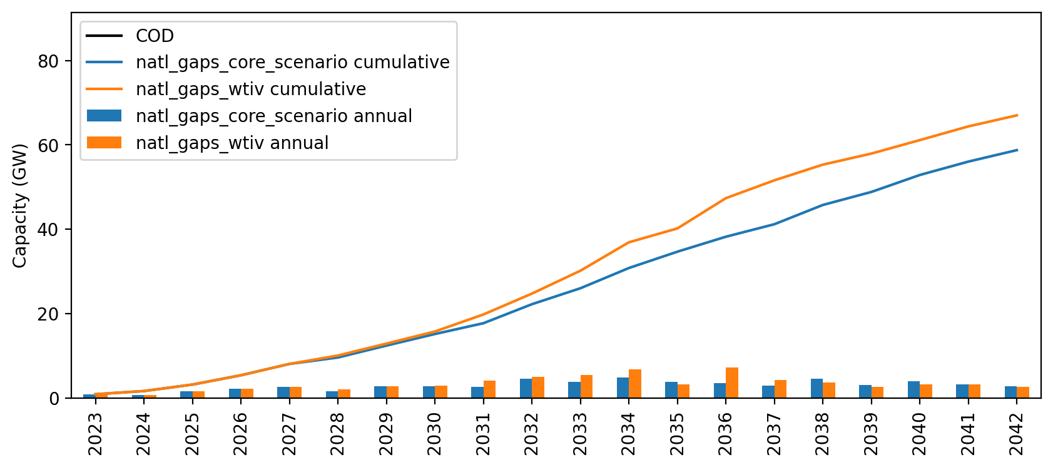
Installed Capacity

